Slide 1
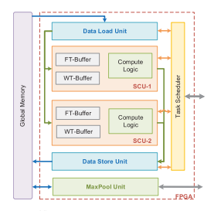
Sparse-YOLO
Hardware/Software Co-Design of an FPGA Accelerator for YOLOv2

Slide 2
Introduction
You Only Look Once (YOLO) is a Convolutional Neural Network (CNN) based object detection algorithm that balances speed and accuracy.
However, balancing energy consumption and high throughput is still very challenging.
A HW/SW Co-design flow is proposed for CPU+FPGA platforms including
  A sparse-convolution algorithm for the YOLOv2 framework.
  A resource efficient FPGA accelerator using parallel convolution cores and algorithm-level optimizations.
  Design space exploration resulting in two HW/SW partitioning strategies.
The final design peaks at 72.5 fps under 211 MHz with 74.45% detection accuracy and a 20x memory footprint reduction. Workload is reduced by 7x , while results show this is the best YOLO accelerator yet.

Slide 3
FPGA-based CNN accelerators: Why and How
FPGAs have flexible architecture, low power consumption and fast development cycle, especially with HLS.
Based on the convolution algorithm approach, YOLO accelerator designs can be divided in three main types.
Spatial convolution with a massive amount of Multiply Accumulate (MAC) operations on DSP blocks. Maximum performance is directly determined by the hardware available DSPs.
Replacing the demanding MAC operations with low-bit operations (AND, XOR), to utilize the more abundant logic resource of the FPGA. Low precision networks translate to serious accuracy loss.
Utilizing frequency-domain convolution (i.e. FFT), reducing overall DSP demand and increasing throughput.
Sparse convolution shows even better performance and is selected here.

Slide 4
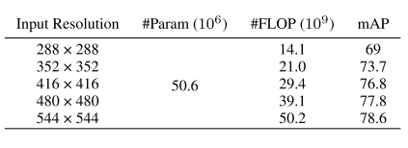
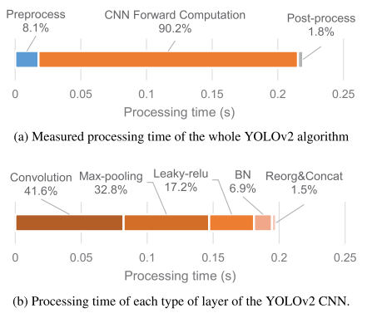
Review and profiling of YOLOv2
To facilitate the correct HW/SW partitioning methodology, the detailed execution time of each procedure has been measured.
The key is developing a dedicated hardware processor that can efficiently accelerate the forward computation of CNN.
Two partitioning strategies are proposed based on different platforms
One for embedded, where all of YOLOv2 is implemented on FPGA.
One for platforms with powerful CPUs on which non-performance critical layers are allocated. This way all of the hardware is used to accelerate convolution and maximize performance.

Slide 5
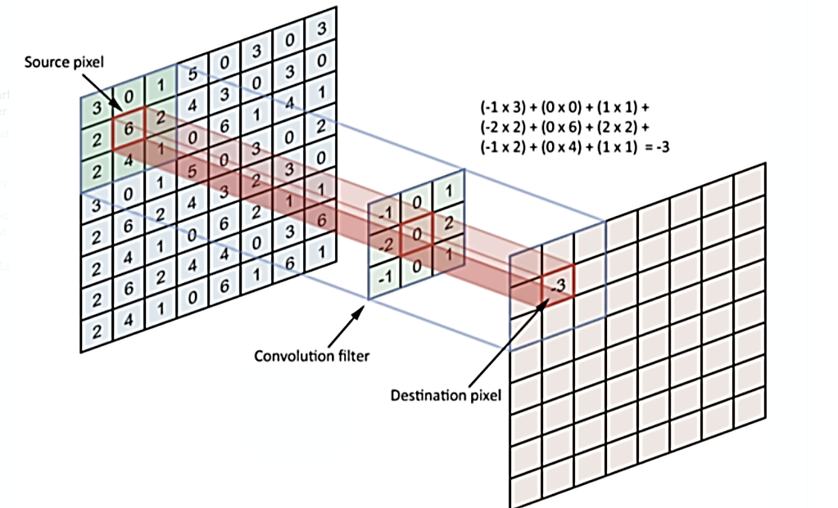
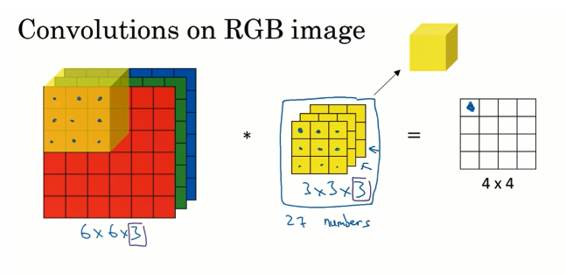
How convolution works

Slide 6
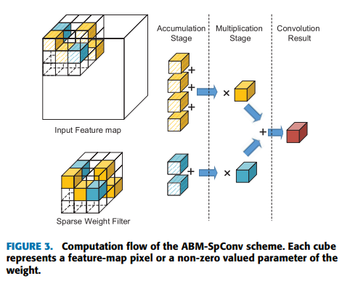

The ABM-SpConv Algorithm
The idea is to decouple the accumulate and multiply operations into two stages.
The complexity of multiplication is greatly reduced over accumulation by sharing unique quantized weights. This significantly reduces DSP demand.
Given Q quantization values, a weight kernel is WTj (j =1,..,Q) . The result can be written as
For every non-zero unique weight value in a kernel, find all input pixels that are multiplied by that value. First accumulate, then multiply. This avoids redundant multiplications and reduces computational workload.

Slide 7
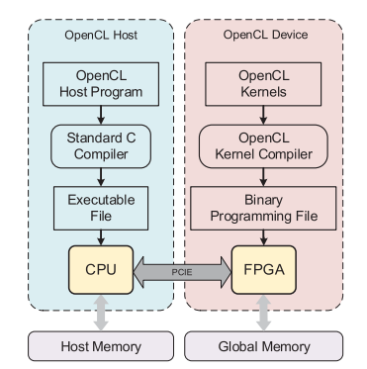
Overview of system design
The OpenCL framework was adopted to develop both HW and SW partitions.
Hardware circuits are first modeled in OpenCL and then compiled with HLS.
Data are transmitted between the CPU and FPGA through the PCIe link with very high throughput.
The CPU and FPGA device can also perform independent computation tasks asynchronously in parallel.

Slide 8
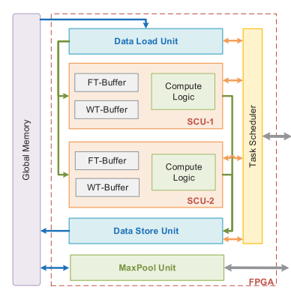
A deeper look in the architectural hardware design
The accelerator consists of
  A task scheduler
  A pair of Data Load/Store Units (DLU/DSU)
  Multiple Sparse Convolution Units (SCU) and interfaces for DDR and PCIe.
  A Max-Pooling Unit (MPU) for the all-hardware platforms.
The task scheduler launches and synchronizes the SCUs and receives signals and input data from the host CPU through PCIe.
It periodically detects idle SCUs and assigns it a new task, after commanding the DLU/DSU to load required input and weight data.
SCUs then work independently.

Slide 9
DLUs and SCUs
For every layer of convolution the DLU first reads a window of input image data from DDR and broadcasts it to each SCU simultaneously.
Then, then it loads the required weight kernels in a round-robin way.
After all tasks are done the DLU stops and waits for new commands.
SCUs are implemented as two OpenCL kernels. The Accumulation and Multiplication Engine (AE) and (ME).
Every cycle, the non-zero weights are read from the weight buffer (WT-Buffer) and pixels are loaded from the FT-Buffer.

Slide 10
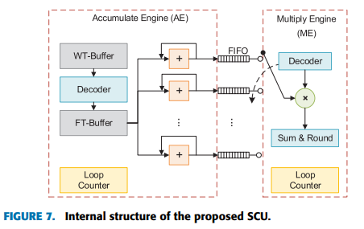
After all the pixels that share the same WTj are accumulated, they are sent in the following FIFO.
The accumulators inside a AE are divided in Nam groups that share one multiplier. In a Round-Robin order, the multiplier selects its input source FIFO.
Nam should match the proportional complexity of multiplications and accumulation. A higher value can save DSP resources at the cost of detection accuracy.
We must find the desired balance between accuracy and hardware cost.

Slide 11
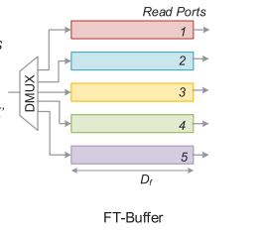
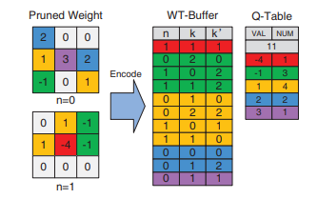
Buffer design and max pooling units
Convolutions are based on successive sliding windows which normally have a lot of overlapping area.
Input data is first read from DDR and written in the FT-Buffer line-by-line.
The input pixels corresponding to Ny sliding windows are read out from parallel ports. Along the column direction, Ny convolutions can be conducted at the same time.
Weights in the WT-Buffer are also compressed by eliminating zero values and only keeping coordinates, reducing memory usage 20x.
The MPU for the powerful CPU platform SIMD extensions and Pthreads were adopted.

Slide 12
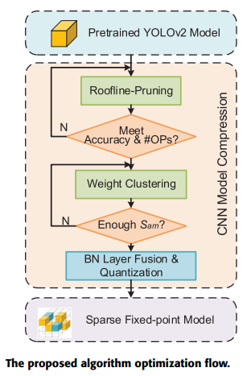
Hardware-aware algorithm level optimizations
The proposed optimization flow consists of three steps
Model pruning balances the reduction in model size and arithmetic intensity.
Weight Clustering optimizes the distribution of the values so that the number of accumulate #ops in proportion to multiply #ops matches the hardware parameter Nam .
BN Fusion fuses the BN layer in the convolution layer.

Slide 13
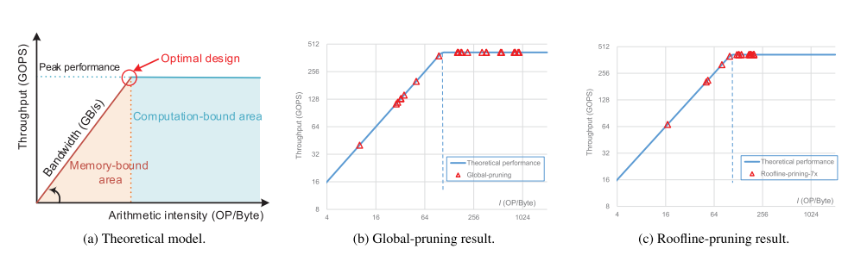
Roofline-model based weight pruning
According to the roofline model theory, the maximum performance of a certain hardware processor is bounded by either on-chip computational resources or external memory bandwidth.
For a given algorithm, low arithmetic intensity makes it fall in the memory-bound area of the diagram since DDR cannot provide enough data fast enough. As the pruning rate PRj increases the arithmetic intensity decreases.
There is a maximum value of PRj guaranteeing that the accelerator falls in the optimal point.

Slide 14
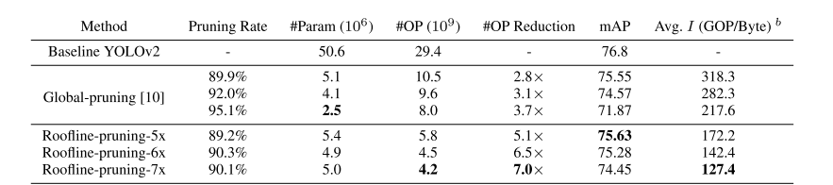
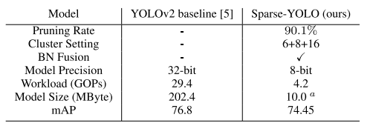
Experiments and Results
The final design was installed on Arria-10 GX1150 FPGA and a workstation with 64GB RAM and i9-9900k CPU.
For Roofline pruning, results show a 5.1x workload reduction at cost of 1% accuracy while in [10] only 2.8x.
For the final design, the 7x reduction is selected with a 2% accuracy drop, which based on experience is not significant in real-world.
For Weight clustering, it was found that for most layers 16 clustering classes greatly reduce multiplication workload, except for the first and second layer.
The combination “6+8+16” is selected as optimal.

Slide 15
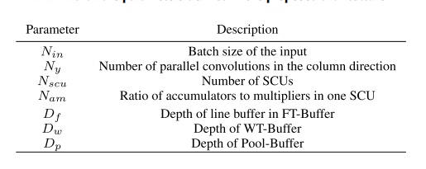
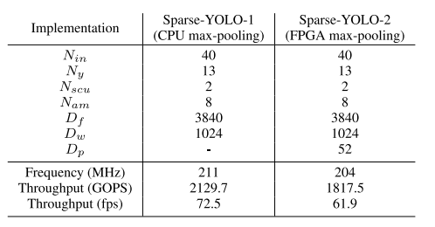
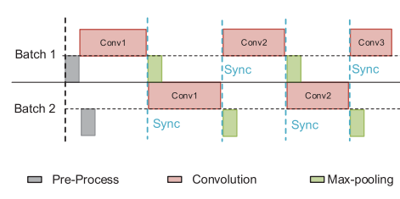

Design Space Exploration
The DSE Flow is implemented as a python script which automatically launches multiple rounds of designs with different parameters and collects and analyzes the results.
Two final designs are selected.
Sparse-YOLO-1 implements only convolution on FPGA, whereas Sparse-YOLO-2 also implements max-pooling.
Experiments show that the max-pooling time on Sparse-YOLO-1 can efficiently be hidden with the following pipeline.

Slide 16
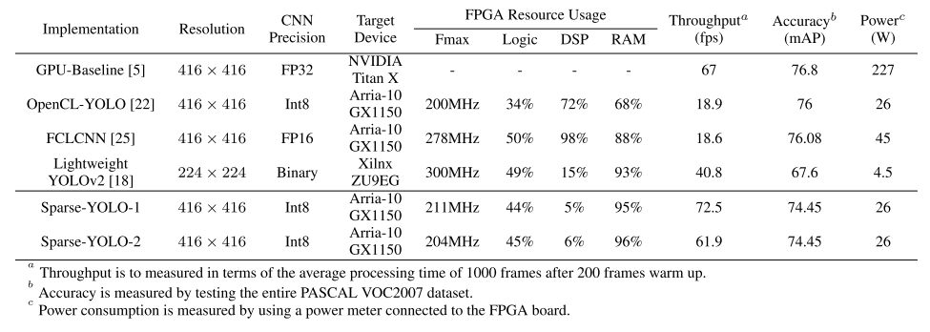
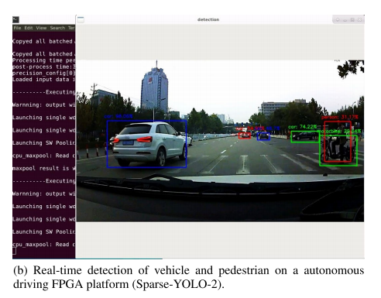
Detection Results and comparison with state-of-the-art
All FPGA based accelerators shown implement different convolution strategies.
Compared to baseline YOLOv2 on GPU, Sparse-YOLO-1 achieves 8% increased throughput with only 2% less accuracy.
The most significant advantage is the 8.7x reduction in energy consumption. The high energy efficiency makes the accelerator an ideal choice for Internet of Things (IoT) or edge computing applications.
Compared to [22] and [25] it has 3.8x and 3.3x greater throughput while using a lot less DSPs

Slide 17
Conclusion
The implemented design is, as far as results show, the best current YOLOv2 accelerator.
However, its performance is only marginally better from the baseline model on a GPU and with a small accuracy drop.
Why use such an advanced design while GPUs have relatively the same performance with very easy interfacing?
Is energy efficiency the only factor?
If yes, then are these accelerator designs more suitable for embedded platforms like autonomous cars?
A fully autonomous 5 hour drive with Titan X GPU would cost 1.12 kWh while with the Sparse-YOLO-1 accelerator only 0.13 kWh.
Titan X GPU costs ~ 1250 while Arria-10 GX1150 FPGA ~ 4500

